Slide 1
Compiler Design Unit I – Part 1
Finite automation – deterministic
Finite automation - non deterministic
Conversion of NFA to DFA
Minimization of DFA

Slide 2

Reference Book:

Slide 3
Finite Automata
Finite automata are used to recognize patterns.
It takes the string of symbol as input and changes its state accordingly. When the desired symbol is found, then the transition occurs.
At the time of transition, the automata can either move to the next state or stay in the same state.
Finite automata have two states, Accept state or Reject state. When the input string is processed successfully, and the automata reached its final state, then it will accept.

Slide 4
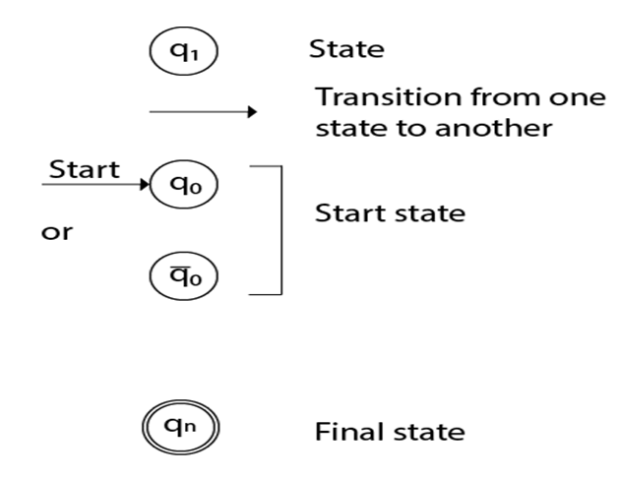
A finite automaton is a collection of 5-tuple (Q, ∑, δ, q0, F), where:
Q: finite set of states
∑: finite set of the input symbol
q0: initial state
F: final state
δ: Transition function

Slide 5
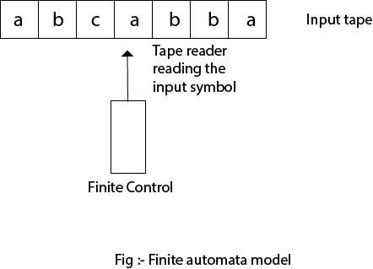
Finite Automata Model:
Finite automata can be represented by input tape and finite control.
Input tape: It is a linear tape having some number of cells. Each input symbol is placed in each cell.
Finite control: The finite control decides the next state on receiving particular input from input tape. The tape reader reads the cells one by one from left to right, and at a time only one input symbol is read.

Slide 6
There are two types of finite automata:
DFA(deterministic finite automata)
NFA(non-deterministic finite automata)
1. DFA
DFA refers to deterministic finite automata. Deterministic refers to the uniqueness of the computation. In the DFA, the machine goes to one state only for a particular input character. DFA does not accept the null move.
2. NFA
NFA stands for non-deterministic finite automata. It is used to transmit any number of states for a particular input. It can accept the null move.

Slide 7
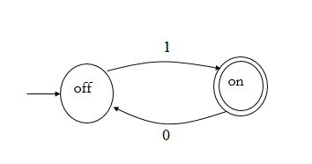
Every DFA is NFA, but NFA is not DFA.
There can be multiple final states in both NFA and DFA.
DFA is used in Lexical Analysis in Compiler.
NFA is more of a theoretical concept.

Slide 8
Deterministic Finite Automata (DFA)
The finite automata are called deterministic finite automata if the machine is read an input string one symbol at a time.
In DFA, there is only one path for specific input from the current state to the next state.
DFA does not accept the null move, i.e., the DFA cannot change state without any input character.
DFA can contain multiple final states. It is used in Lexical Analysis in Compiler.

Slide 9
A DFA is a collection of 5-tuples same as we described in the definition of FA.
Q: finite set of states
∑: finite set of the input symbol
q0: initial state
F: final state
δ: Transition function
Transition function can be defined as:
δ: Q x ∑→Q

Slide 10

Example 1:
Q = {q0, q1, q2}
∑ = {0, 1}
q0 = {q0}
F = {q2}
Transition Table:
Present State | Next state for Input 0 | Next State of Input 1
→q0 | q0 | q1
q1 | q2 | q1
*q2 | q2 | q2

Slide 11
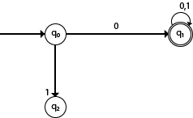

Example 2:
DFA with ∑ = {0, 1} accepts all starting with 0.
Example 3:
DFA with ∑ = {0, 1} accepts all ending with 0.

Slide 12
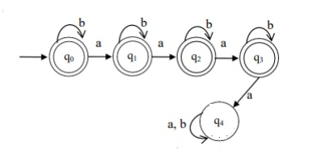
Example 4:
Design a DFA that accepts at most 3 a"s

Slide 13
Non-Deterministic finite automata(NFA)
The finite automata are called NFA when there exist many paths for specific input from the current state to the next state.
Every NFA is not DFA, but each NFA can be translated into DFA.
NFA is defined in the same way as DFA but with the following two exceptions, it contains multiple next states, and it contains ε transition.
NFA also has five states same as DFA, but with different transition function, as shown follows:
δ: Q x ∑ →2^Q

Slide 14
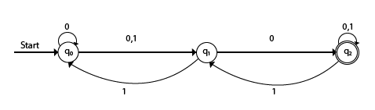
Present State | Next state for Input 0 | Next State of Input 1
→q0 | q0, q1 | q1
q1 | q2 | q0
*q2 | q2 | q1, q2

Slide 15

Example:
NFA with ∑ = {0, 1} accepts all strings with 01.
Present State | Next state for Input 0 | Next State of Input 1
→q0 | q1 | ε
q1 | ε | q2
*q2 | q2 | q2

Slide 16
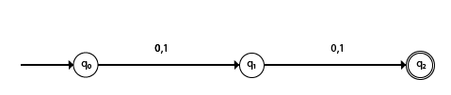
Example:
NFA with ∑ = {0, 1} and accept all string of length atleast 2.
Present State | Next state for Input 0 | Next State of Input 1
→q0 | q1 | q1
q1 | q2 | q2
*q2 | ε | ε

Slide 17
Design a NFA for the transition table as given below
:
Present State | 0 | 1
→q0 | q0, q1 | q0, q2
q1 | q3 | ε
q2 | q2, q3 | q3
→q3 | q3 | q3

Slide 18
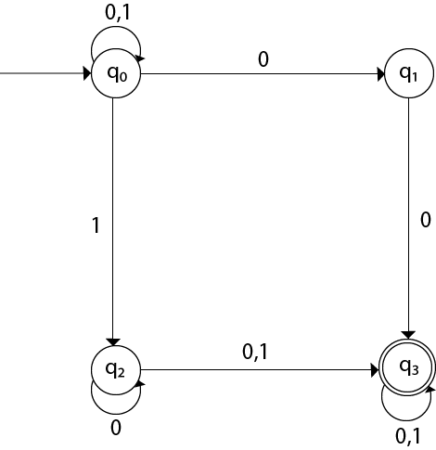

Slide 19

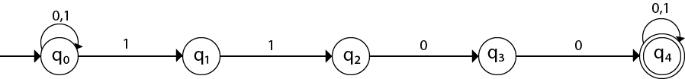
Example:
Design an NFA with ∑ = {0, 1} accepts all string ending with 01.
Design an NFA with ∑ = {0, 1} in which double '1' is followed by double '0'.

Slide 20
Conversion of NFA to DFA:
Step 1 − Create state table from the given NDFA.
Step 2 − Create a blank state table under possible input alphabets for the equivalent DFA.
Step 3 − Mark the start state of the DFA by q0 (Same as the NDFA).
Step 4 − Find out the combination of States {Q₀, Q₁,... , Q_{n}} for each possible input alphabet.
Step 5 − Each time we generate a new DFA state under the input alphabet columns, we have to apply step 4 again, otherwise go to step 6.
Step 6 − The states which contain any of the final states of the NDFA are the final states of the equivalent DFA.

Slide 21
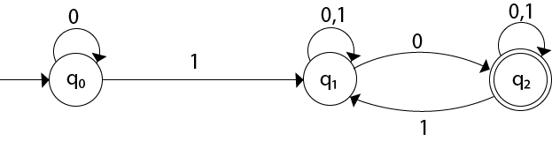
Example:
State | 0 | 1
→q0 | q0 | q1
q1 | {q1, q2} | q1
*q2 | q2 | {q1, q2}

Slide 22
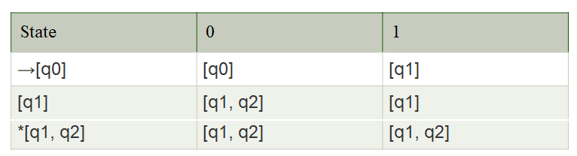
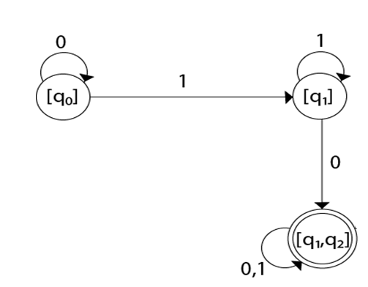

Slide 23
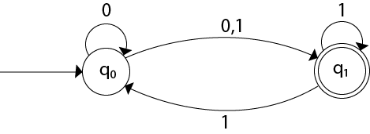
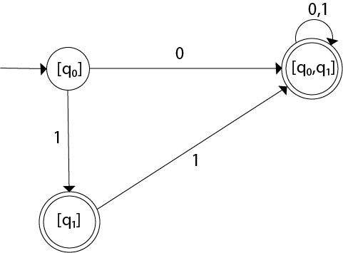
Example:
State | 0 | 1
→q0 | {q0, q1} | {q1}
*q1 | ϕ | {q0, q1}
State | 0 | 1
→[q0] | [q0, q1] | [q1]
*[q1] | ϕ | [q0, q1]
*[q0, q1] | [q0, q1] | [q0, q1]

Slide 24
Minimization of DFA
Step 1: Remove all the states that are unreachable from the initial state via any set of the transition of DFA.
Step 2: Draw the transition table for all pair of states.
Step-03: Now, start applying equivalence theorem.
Take a counter variable k and initialize it with value 0.
Divide Q (set of states) into two sets such that one set contains all the non-final states and other set contains all the final states.
This partition is called P0.

Slide 25
Step-04: Increment k by 1.
Find Pk by partitioning the different sets of Pk-1 .
In each set of Pk-1 , consider all the possible pair of states within each set and if the two states are distinguishable, partition the set into different sets in Pk.
Step-05: Repeat step-04 until no change in partition occurs. In other words, when you find Pk = Pk-1, stop.
Step-06: All those states which belong to the same set are equivalent.
The equivalent states are merged to form a single state in the minimal DFA.

Slide 26
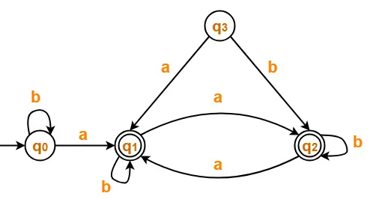
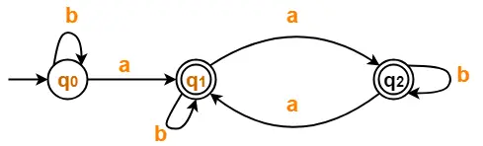
Example 1:
Step-01:
State q₃ is inaccessible from the initial state.
So, we eliminate it and its associated edges from the DFA.

Slide 27
Step-02:
Draw a state transition table-
 | a | b
→q0 | *q1 | q0
*q1 | *q2 | *q1
*q2 | *q1 | *q2

Slide 28
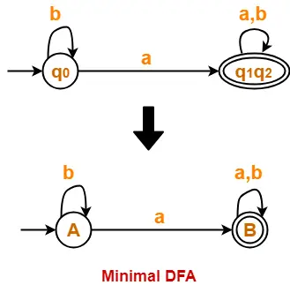
Step 3: P₀ = { q₀ } { q₁ , q₂ }
Step 4: P₁ = { q₀ } { q₁ , q₂ }
Since P₁ = P₀, so we stop.
From P₁, we infer that states q₁ and q₂ are equivalent and can be merged together.

Slide 29
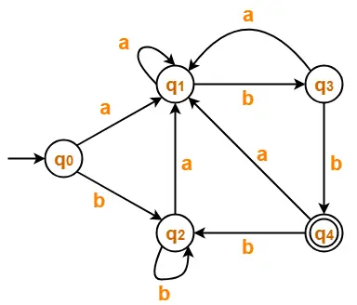
Example 2:
 | a | b
→q0 | q1 | q2
q1 | q1 | q3
q2 | q1 | q2
q3 | q1 | *q4
*q4 | q1 | q2
Step-01:
The given DFA contains no dead states and inaccessible states.
Step-02:
Draw a state transition table-

Slide 30
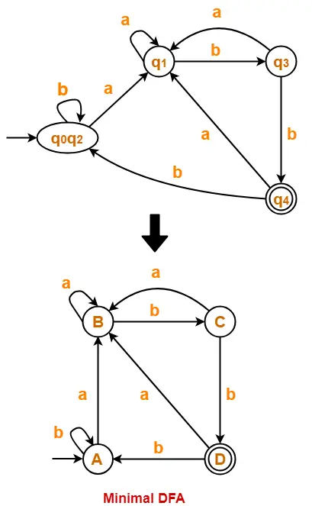
Step-03:
Now using Equivalence Theorem, we have-
P₀ = { q₀ , q₁ , q₂ , q₃ } { q₄ }
P₁ = { q₀ , q₁ , q₂ } { q₃ } { q₄ }
P₂ = { q₀ , q₂ } { q₁ } { q₃ } { q₄ }
P₃ = { q₀ , q₂ } { q₁ } { q₃ } { q₄ }
Since P₃ = P₂, so we stop.
From P₃, we infer that states q₀ and q₂ are equivalent and can be merged together.

